Slide 1
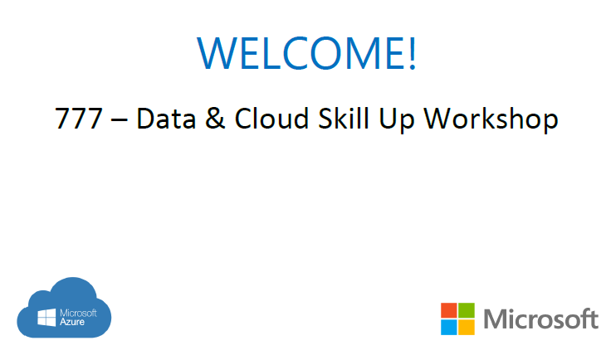
Azure Cosmos DB Workshop

Slide 2
Hello
Ana Gil
Certifications: MCT, MCSA, MCSD, MCP, Master SCRUM.
Few things about me: 10 years in the IT field, software development consultant, developer, DBA, tester, Sr. Software developer coordinator.
agil@mstecs.com
Ali Kazmi
Data & Ai | Technology Solutions Professional
Few things: 2.5 Years with Microsoft, previously worked with a Microsoft partner for two years where I started their Managed Service and Marketing initiatives. Working in Sales for 10 years in total.
Akazmi@Microsoft.com
Notes:
But lets move forward, because the course is not about me, during the course I will give you real examples based on my experience.
Something that I want to tell you is that I like the students to participate, to interact, I don’t want to just keep talking and talking and maybe boring you. So please feel free to ask any question at any time, or to give an example if you have one relate with the topic that we are discussing, or if you have any participation, go ahead, ok?
Lets start with the first participations so please tell me about you, your experience, what yo do in your job and if you have any certification.

Slide 3
Exam 70-777 Implementing Microsoft Azure Cosmos DB Solutions
Partition and Model Data
Replicate Data Across the World
Tune and Debug Azure Cosmos DB Solutions
Perform Integration and Develop Solutions
https://www.microsoft.com/en-ie/learning/exam-70-777.aspx
Notes:
20533D
1: Introduction to Microsoft Azure

Slide 4
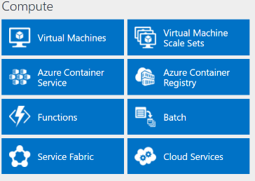
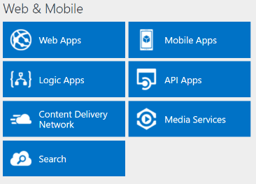
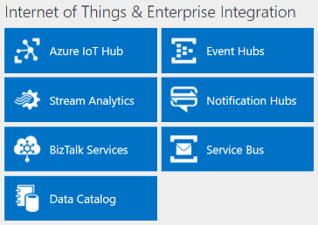
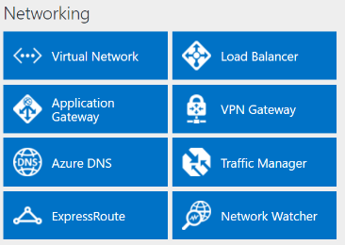
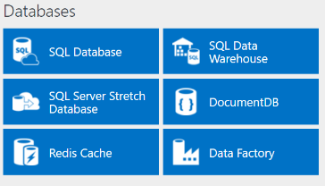
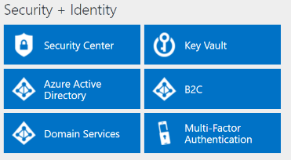
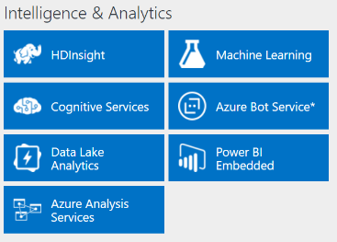
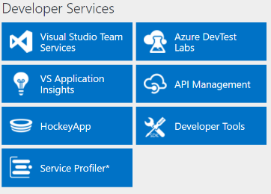
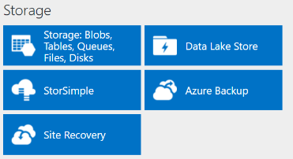
http://azureplatform.azurewebsites.net/
* Preview Services
Notes:
Preview Version 1.7 (2017-04-20)

Slide 5
Partition and Model Data
Plan a partitioning strategy
Model data based on business use cases
https://www.microsoft.com/en-ie/learning/exam-70-774.aspx

Slide 6
Partition and Model Data
Plan a partitioning strategy
Select a partition key for a container; differentiate between partition keys and partition key ranges; partition data across multiple containers; calculate throughput distribution across partition key ranges; control cross-partition queries; plan for transactions
Model data based on business use cases
Identify when to co-locate data within the same container or across multiple containers; identify when to co-locate data within the same partition key or across multiple partition keys; identify when to co-locate data within the same document or across multiple documents; share properties between documents
https://www.microsoft.com/en-us/learning/exam-70-777.aspx
Notes:
The following topics are not included in this presentations due to time constrains

Slide 7
Replicate Data Across the World
Implement global distribution and high availability
Select a data consistency approach based on business use cases

Slide 8
Replicate Data Across the World
Implement global distribution and high availability
Replicate data to additional regions; define automatic failover policies for disaster recovery; perform manual failovers to change the write region; set the preferred location of applications for low-latency access; design patterns for multi-write regions; resolve conflicts surfaced by the conflict feed
Select a data consistency approach based on business use cases
Identify use cases for consistencies; differentiate between consistencies by using characteristics; differentiate between consistencies by using trade-offs between performance and consistency; use session tokens
https://www.microsoft.com/en-us/learning/exam-70-777.aspx
Notes:
The following topics are not included in this presentations due to time constrains

Slide 9
Tune and Debug Azure Cosmos DB Solutions
Estimate and provision request units
Tune container settings
Implement security
Debug a Cosmos DB solution

Slide 10
Tune and Debug Azure Cosmos DB Solutions
Estimate and provision request units
Differentiate requests and request units; retrieve request unit cost of an operation; estimate request unit allocation for a container; tune throughput for uneven workloads and manage throttling; monitor Azure portal metrics; recommend solutions based on query metrics
Tune container settings
Manage lifecycle of data by using TTL; tune an index policy; include and exclude properties from index paths
Implement security
Secure access to data; rotate keys; understand encryption at rest and in transit; configure IP firewalls; create and manage users; configure fine-grained access to resources
Debug a Cosmos DB solution
Configure diagnostic logging; recommend solutions based on data retrieved from logs; evaluate response status code categories; throttle; review metrics and performance tips
https://www.microsoft.com/en-us/learning/exam-70-777.aspx
Notes:
The following topics are not included in this presentations due to time constrains

Slide 11
Perform Integration and Develop Solutions
Develop applications with the SQL API
Migrate from MongoDB to MongoDB API in Cosmos DB
Implement event-driven applications by using Azure functions, triggers and Cosmos DB change feed
Analyze Cosmos DB data with Apache Spark connector

Slide 12
Perform Integration and Develop Solutions
Develop applications with the SQL API
Optimize SDK and concurrency control; Tune request options for CRUD and queries; examine response headers; implement optimistic concurrency control with ETAG; query geospatial data; use advanced SQL query operators for complex documents (nested objects and arrays); perform intra-document JOINs; perform SQL queries; implement user-defined functions; use multi-record transactions with stored procedures; implement a continuation model for bounded execution with stored procedures; implement server-side logic and transactions
Migrate from MongoDB to MongoDB API in Cosmos DB
Choose appropriate tools to migrate data; transfer data
Implement event-driven applications by using Azure functions, triggers and Cosmos DB change feed
Use Cosmos DB triggers for Azure functions; change feed mechanics
Analyze Cosmos DB data with Apache Spark connector
Set up and configure a Cosmos DB Spark connector; push down predicates
https://www.microsoft.com/en-us/learning/exam-70-777.aspx
Notes:
The following topics are not included in this presentations due to time constrains

